Slide 1


United Curriculum
Primary Science

Slide 2
Principles of the Science Curriculum
The United Curriculum for science provides all pupils, regardless of their background, with:
Substantive knowledge:
Ensuring pupils master core content through the development of key concepts and timely revisiting of key knowledge
Sequencing the curriculum and selecting knowledge to allow for gradual development of vertical concepts – the ‘big ideas’ in science – to provide firm foundations for KS3 and KS4
Preventing common misconceptions that are often formed at an early age and prove problematic at the later stages of pupils’ science education
Purposefully teaching appropriate knowledge that goes beyond the KS1 and KS2 national curriculum, to aid current and future understanding, and to smooth the transition to KS3
Encouraging pupils to apply and make connections between the disciplines of science, the wider curriculum and the wider world
Disciplinary knowledge:
Sequencing Working Scientifically elements so that they are explicitly taught and practised alongside the substantive knowledge, and regularly reviewed and built upon across the years and key stages
Making deliberate and explicit links to other curriculum areas – particularly geography and mathematics – to ensure there is a consistent approach to teaching content, and that pupils are always first taught content in the most relevant subject. For example, pupils are taught how to construct bar charts or calculate the mean in mathematics before they are applied in science
Planning practical tasks that have a clear purpose: to demonstrate or prove substantive concepts, or to allow pupils to deliberately practice working scientifically skills in a relevant context
Curiosity and excitement about science:
Selecting examples and applications of science that inspires pupils’ curiosity about the world and natural phenomena
Ensuring that all pupils can see themselves reflected in the science curriculum, by highlighting present-day role models and the contributions of scientists from a wide range of backgrounds; and considering social and cultural values around scientific ideas

Slide 3
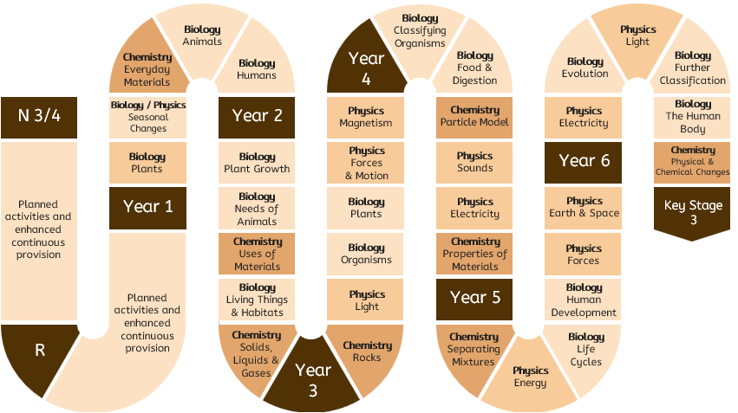
United Curriculum: Science
N 3/4

Slide 4
United Curriculum: Science
 | Year 1 | Year 2 | Year 3 | Year 4 | Year 5 | Year 6
Autumn 1 | BIOLOGY Plants Identifying and naming common plants and describing basic structures | BIOLOGY Plant growth Plants grow from seeds, and require water, light and a suitable temperature | CHEMISTRY Rocks Comparisons of types of rocks and how fossils are formed | BIOLOGY Classifying organisms Introduction to classifying animals and their environment | CHEMISTRY Separating mixtures Identifying and separating mixtures; reversible and non-reversible changes | PHYSICS Electricity Investigating variations in series and parallel circuits, and how electricity is generated
Autumn 2 | BIOLOGY / PHYSICS Seasonal changes Observing changes across four seasons and describing associated weather | BIOLOGY Needs of animals Animals need water, food and air to survive and to have offspring | PHYSICS Light Relationship between light and how we see; the formation of shadows | BIOLOGY Food & digestion The human digestive system and food relationships in ecosystems | BIO / CHEM / PHYSICS Energy Introducing the concept of energy stores and energy transfers; relate this to prior knowledge | BIOLOGY Evolution Fossils; introduction to the idea that adaptation may lead to evolution
Spring 1 | CHEMISTRY Everyday materials Distinguishing objects from their material, and describing simple properties | CHEMISTRY Uses of materials Comparisons of an object’s material with its use; impact of bending, twisting on solid objects | BIOLOGY Organisms The role of muscles and skeletons; the importance of nutrients | CHEMISTRY Particle model and states of matter States of matter in relation to particle arrangement | BIOLOGY Life cycles Life cycles of a mammal, amphibian, insect, bird, and some reproduction processes | PHYSICS Light How light travels and is reflected, and how this allows us to see
Spring 2 | Consolidation and review | BIOLOGY Living things & habitats Introduction to habitats, micro-habitats, and simple food chains | BIOLOGY Plants Features of flowering plants and what they need to survive | PHYSICS Sound Relationship between strength of vibrations and volume of sound | BIOLOGY Human development Human development to old age | BIOLOGY Further classification Further classification of organisms based on characteristics
Summer 1 | BIOLOGY Animals Naming reptiles, fish, amphibians, birds and mammals; carnivores, herbivores, omnivores | CHEMISTRY Solids, liquids and gases How the same substances can exist as solids, liquids and gases | PHYSICS Forces & motion Introducing pushes and pulls; opposing forces, and balanced forces | PHYSICS Electricity Simple series circuits | PHYSICS Forces Gravity, air and water resistance and friction; introduction to pulleys | BIOLOGY Functions of the human body Human circulatory system; transport of nutrients within the body
Summer 2 | BIOLOGY Humans Human body parts and senses | Consolidation and review | PHYSICS Magnetism Contact and non-contact forces, including friction and magnetism | CHEMISTRY Properties of materials Considering physical and chemical properties | PHYSICS Earth and space Movements of planets and the Moon, and relationship to day and night | CHEMISTRY Physical and chemical changes Identifying physical and chemical changes

Slide 5
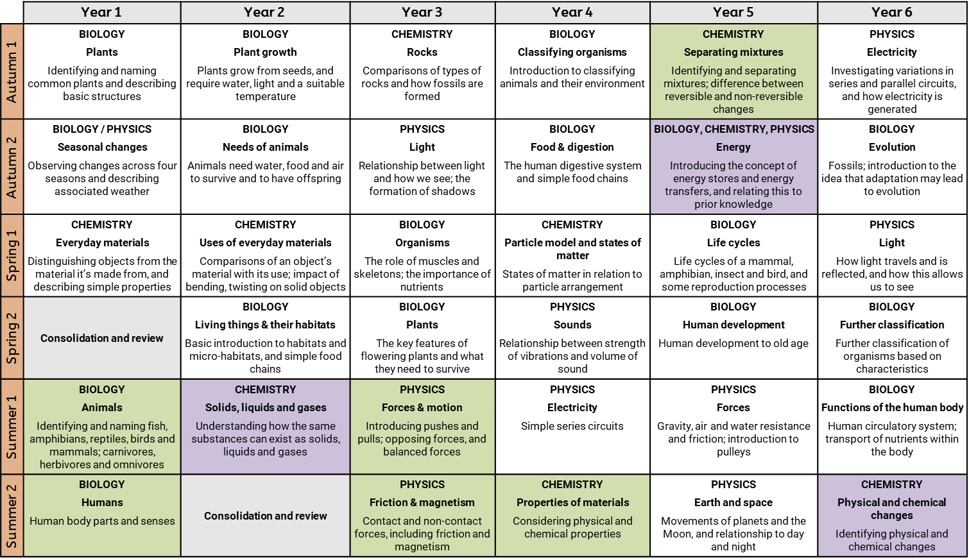
Alignment to the National Curriculum
Substantive knowledge
The units that are not highlighted in colour align directly to the topics in the Programmes of Study and cover – at a minimum – the statutory content set out.
The statutory content in some topics in the Programmes of Study is substantial. Where this is the case, more time has been dedicated to it and the content is split into two complementary units. This allows sufficient time for mastery.
Three additional units purposefully take pupils beyond the Programmes of Study:
Year 2: Solids, liquids and gases. This introduces pupils to the idea that familiar substances (like water or chocolate) can exist as solids, liquids or gases. It will support understanding of states of matter and the particle model in Year 4, and preempts the misconception that substances only ever exist in one state.
Year 5: Energy. This introduces pupils to energy stores and transfers at a very basic level, and has been designed to preempt misconceptions that need to be unpicked at secondary. It also allows pupils to review content from previous topics across biology, chemistry and physics (like food webs, electricity, and states of matter), and consider them through the lens of energy.
Year 6: Physical & chemical changes. This unit gives pupils the opportunity to run more sophisticated practical investigations. It provides a good transition to Year 7.
There are opportunities for pupils to consolidate or review knowledge in KS1, to ensure that these early concepts are fully mastered before KS2. They also allow time for pupils to revisit ideas in different seasons (e.g. observing changes in spring from autumn).
Disciplinary knowledge (working scientifically)
As specified in the National Curriculum, disciplinary knowledge is not taught as a separate strand. Instead, very specific aspects of disciplinary knowledge (for example, recognising and managing risk; or measuring using a Newtonmeter) are explicitly taught as part of the units set out here. They are deliberately practiced in the context of relevant and appropriate experiments, and then reviewed at regularly intervals across the key stages.

